Slide 1
Employee Data Analysis using Excel
STUDENT NAME : S.Sruthi
REGISTER NO : 2213391036050
DEPARTMENT : commerce
COLLEGE : queen Mary’s college

Slide 2
PROJECT TITLE
Employee Performance Analysis using Excel

Slide 3


AGENDA
Problem Statement
Project Overview
End Users
Our Solution and Proposition
Dataset Description
Modelling Approach
Results and Discussion
Conclusion
3/21/2024 Annual Review

Slide 4

PROBLEM STATEMENT
Average employee and good performing employee details are involved. If we analyze about it we get improve our organizational goals and objectives and also helps to identify the average employee and move them to do better.

Slide 5

PROJECT OVERVIEW
Collet data of employee then using this collected data in Excel and find the performance level of the employees then using that create a pivot table and finally make a chart about the employee performance from the pivot table.
.

Slide 6
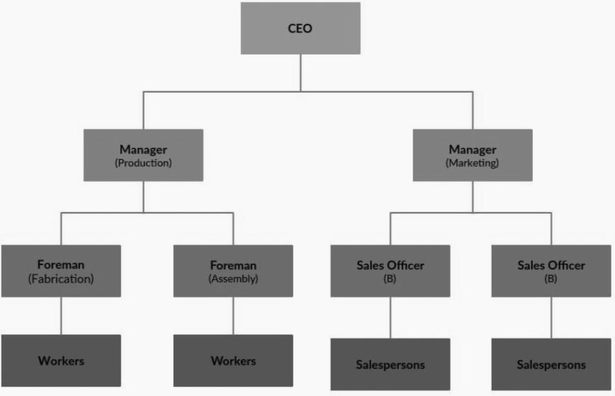

WHO ARE THE END USERS?

Slide 7

OUR SOLUTION AND ITS VALUE PROPOSITION
Employee data – get employee data from kaggle
Conditional formula – find out the performance
level of employee
Filter –to remove the blank
Pivot table – summarize the data collected
Graph - visualize the data through chart

Slide 8
Dataset Description
Employee data – kaggle
26 features
10 features
Employee ID
First name
Business unit
Employee status
Employee type
Employee classification type
Department
Gender code
Performance score
Performance level

Slide 9

THE "WOW" IN OUR SOLUTION
Performance level=IFS(z8>=8,"very high",z8>=4,"high",z8>=3,"med",true,"low")
3/21/2024 Annual Review
9

Slide 10
MODELLING
Data collection
collecting employee data from kaggle
Feature collection
highlighting the important feature from the collected employee data
Performance level
Using conditional formula to ascertain the performance level
Summary
Observe the performance of the employees
10

Slide 11
RESULTS
11

Slide 12
CONCLUSION:
Employee performance analysis leads to identity the average employee and good performing employee.

